Slide 1
Senior Scholarship Info.

Slide 2
Financial Aid FAFSA.ed.gov

Slide 3
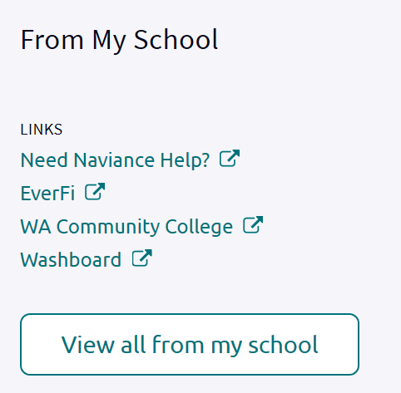
Financial Aid Resources in Naviance

Slide 4
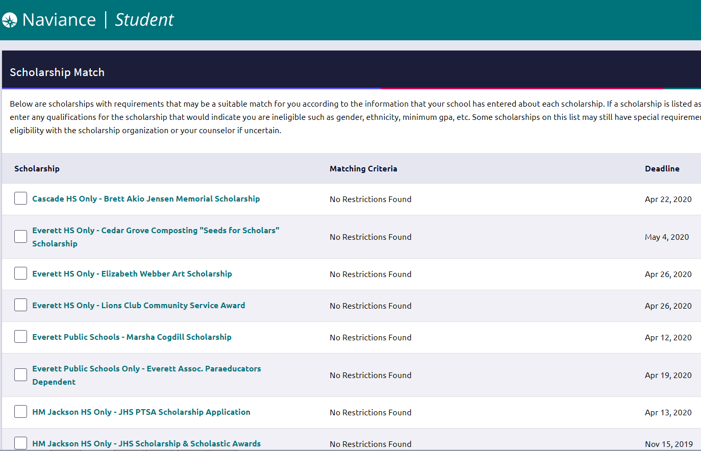
Scholarships

Slide 5
Washington State Schools Call 1-888-535-0747, Option 1 to see if you applied in middle school.

Slide 6
Looking at schools out of state? wiche.edu/wue

